Slide 1
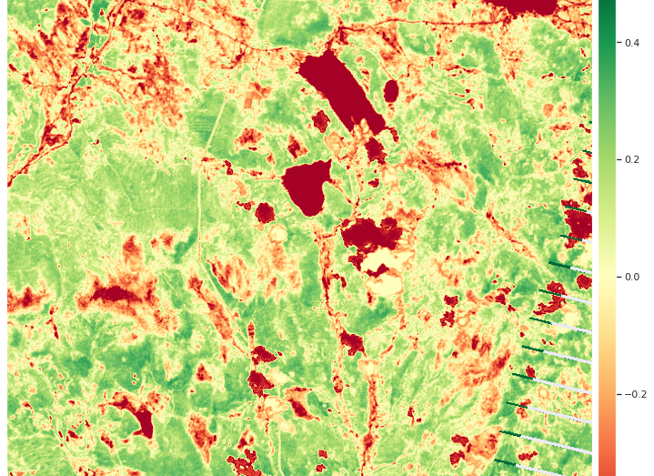
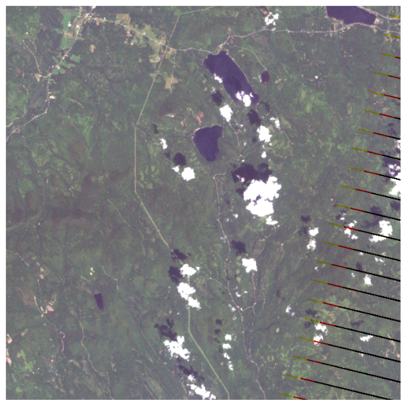
Mystery at the Wildlife Preserve: Multispectral Imagery
Paul Gagliardi- Data Science Capstone

Slide 2
Goals
Using satellite images collected by National Space Service, perform a multispectral analysis of wildlife preserve flora, document changes over time, and describe discernable features in the image

Slide 3
Mistford Wildlife PrEserve
Mistford is a mid-size city is located to the southwest of a large nature preserve. The Rose-crested Blue Pipit is a bird whose life in the wildlife preserve may be under threat. The number of nesting pairs is dropping, so a student has contacted us to examine some satellite imaging data and try to discern if we can notice any changes among the flora that could be impacting the fauna.

Slide 4
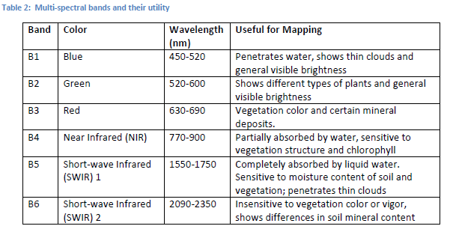
LandSAt & Multispectral Data
Multispectral Data
As the names suggests, multispectral data provides intensity of bandwidths outside visible light
This project has 6 bands which each have unique uses
This data is in the same form as “Landsat” Data
Provided in CSV and TIF files

Slide 5
LandSAt & Multispectral Data Cont.
TIF Files
Accessing TIF and Landsat Data
Landsat files have specific packages made to handle them in python
Geopandas
Well known package for working with geospatial data
rasterio
Used to handle GeoTIFF/raster data
earthpy
Used to work with and plot spatial data quicker than matplot
Xarray, rioxarray
Stands for “Tagged Image Format”
Used for storing raster graphics
Useful for multiband imaging because it can contain layers of images

Slide 6
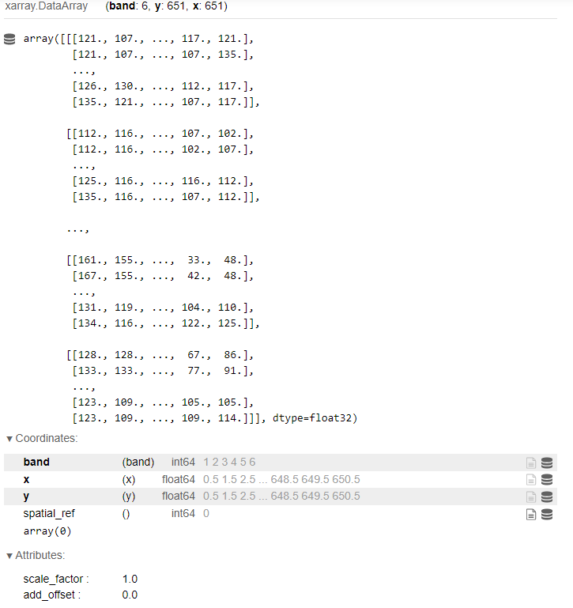
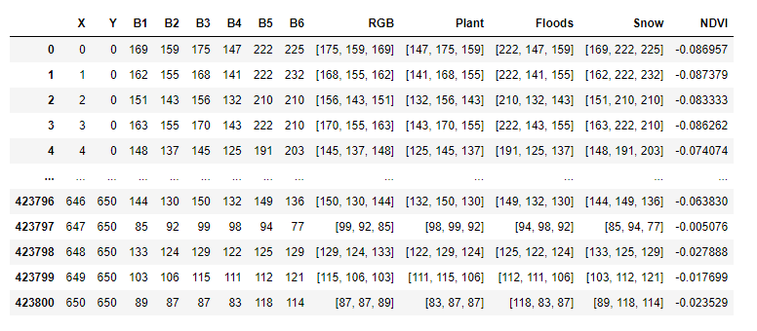
Data Structure
TIF Data Structure
CSV Data Structure

Slide 7
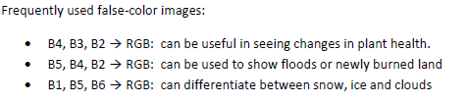
Data Structure
12 Files total over 3 years with roughly 1 per season per year
Time of day/month is not consistent among files and must be considered
Cloud cover, glare, brightness and snow cover are all factors that need to be accounted for in images and have high variability
Must use variations and combinations of bands to get full picture of reserve happenings

Slide 8
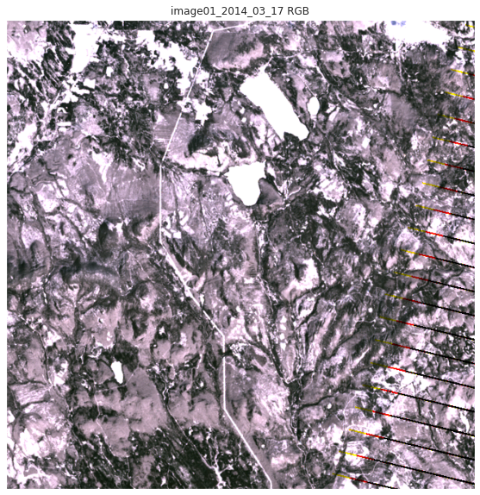
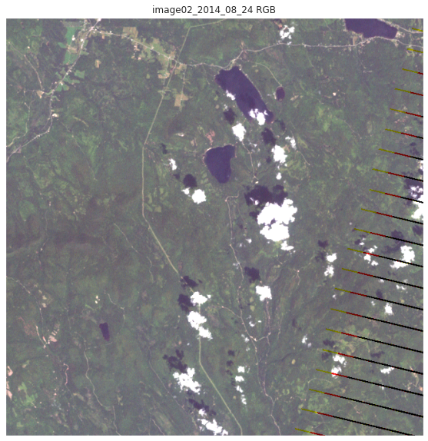
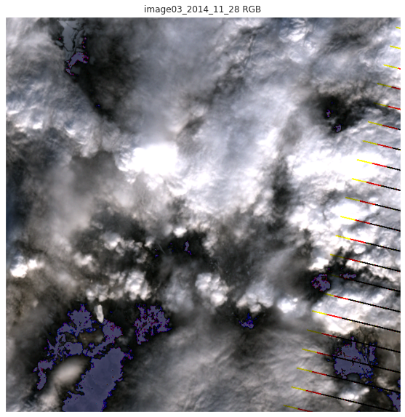
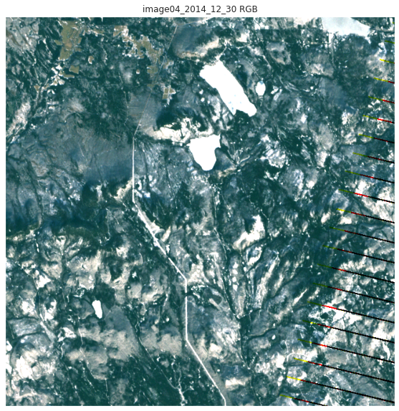
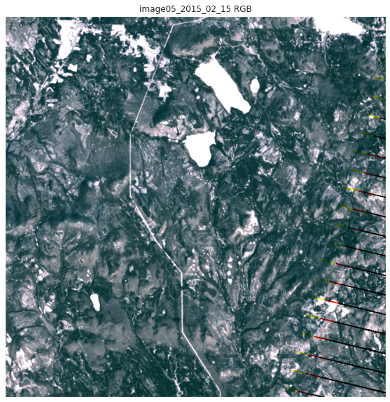
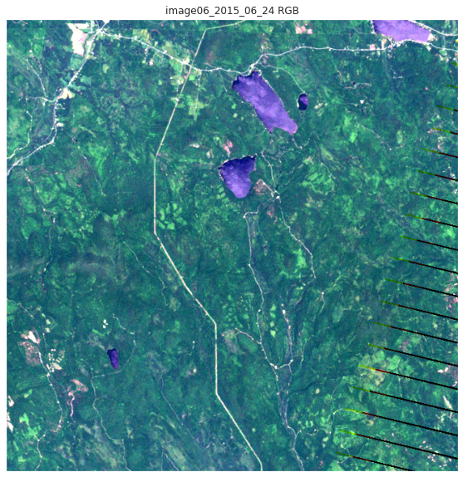
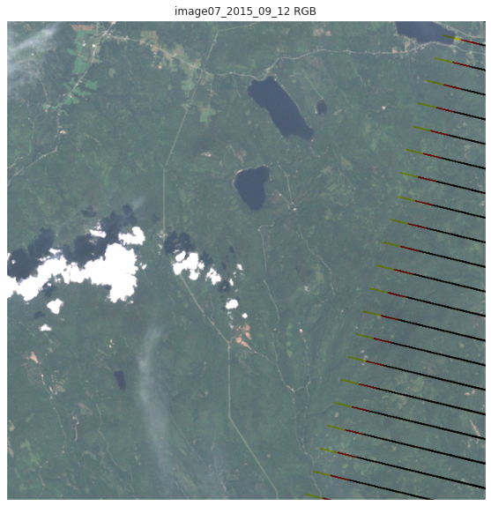
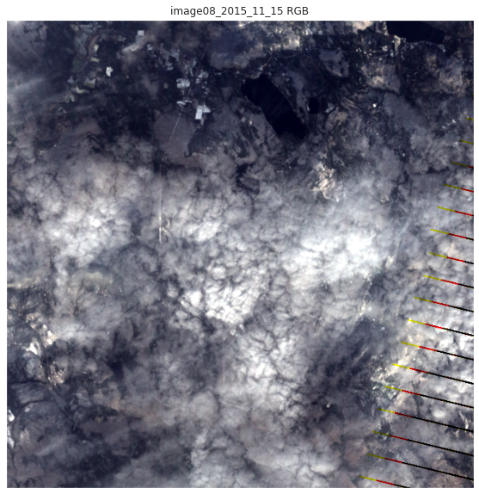
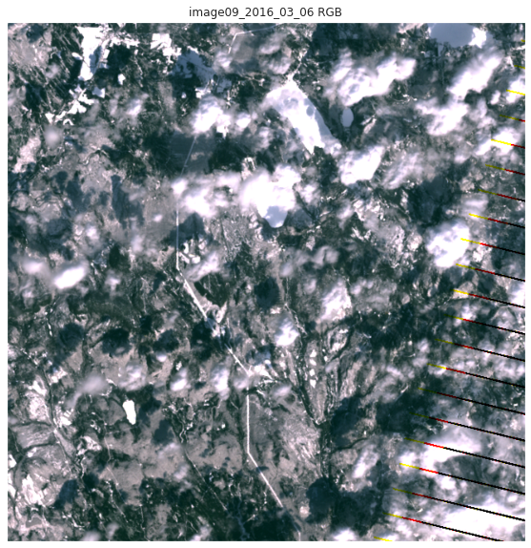
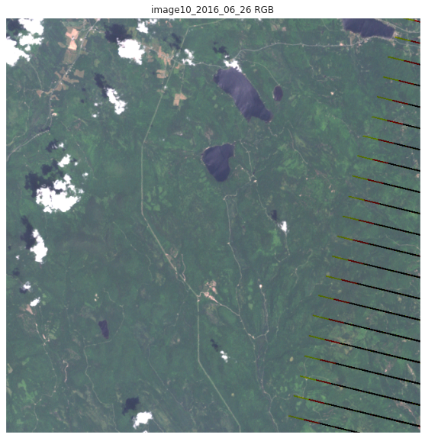
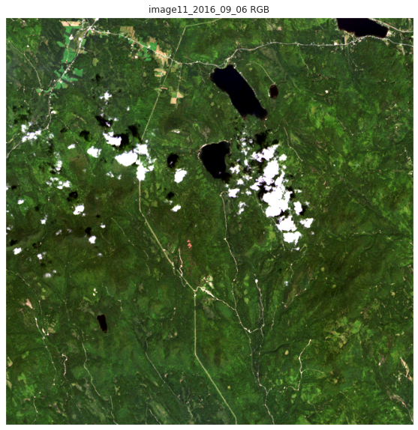
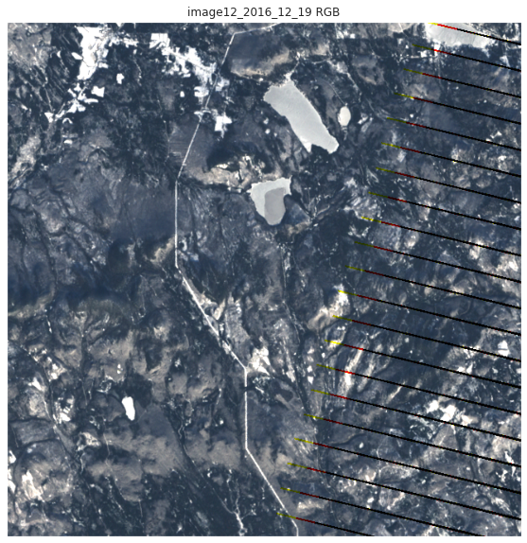
Initial Analysis and Cleaning
Using earthpy packages and TIFs examined all 12 images in RGB true color ​

Slide 9
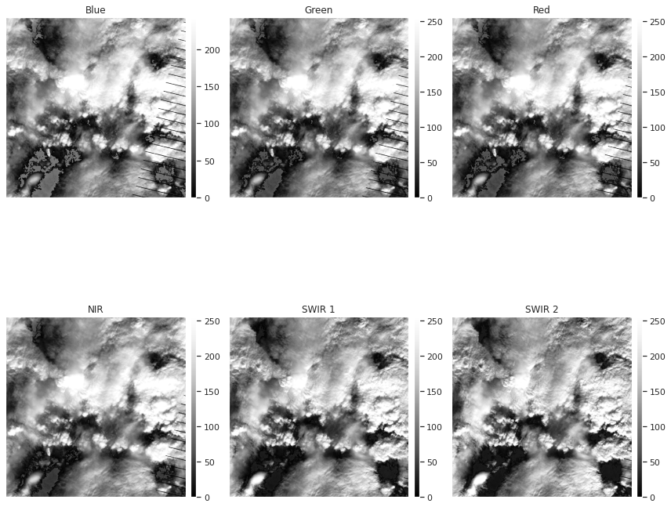
Dropping Cloudy Data

Slide 10
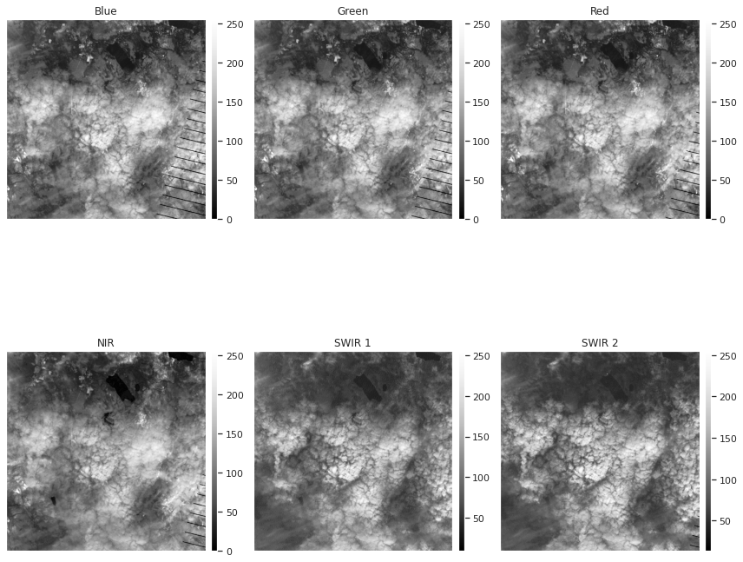
Dropping Cloudy Data

Slide 11
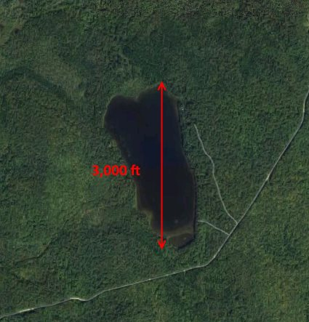
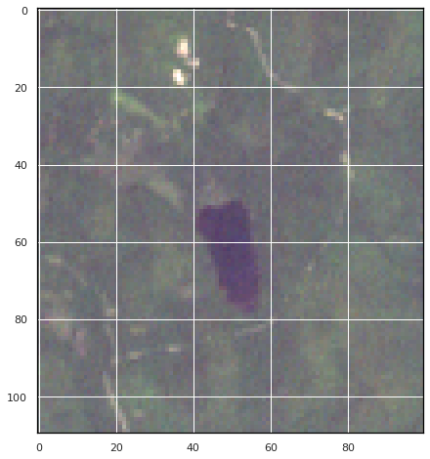
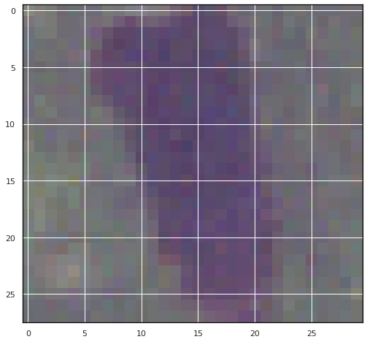
Boonsong Lake

Slide 12
BoonSong Lake
Lake image provided with data, used to orient oneself to the Landsat images
3000 Feet Long in image, about 29 pixels long in Landsat files. Every Pixel is roughly 103.5 feet, and image is has standard north at the top orientation.
Image of 651x651 pixels is therefore about 12.76 by 12.76 miles showing 162.8 sq. mi total
This is comparable to size of Denver Metro Area (154.7 miles)
Considered Medium to Low resolution for Landsat
Reference

Slide 13
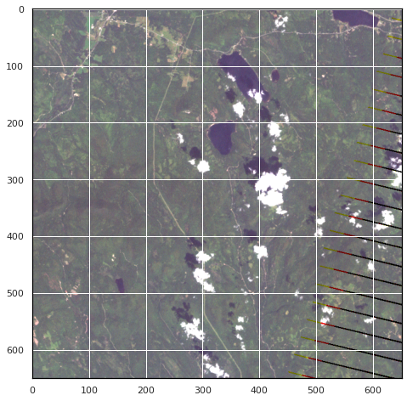
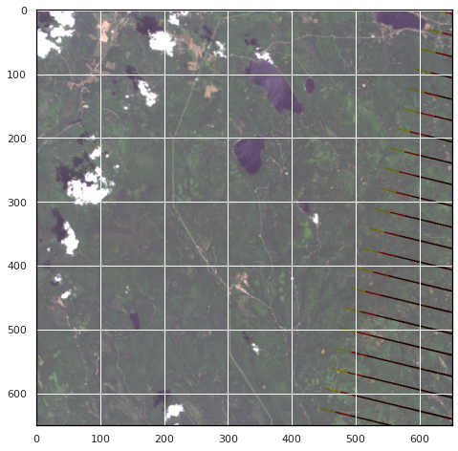
Identifiable Features

Slide 14
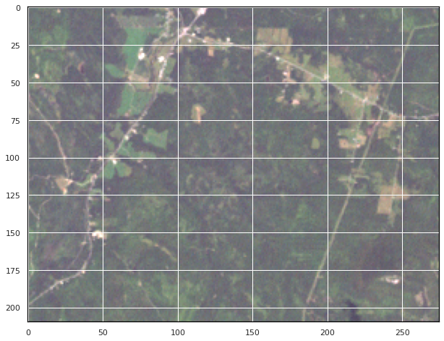
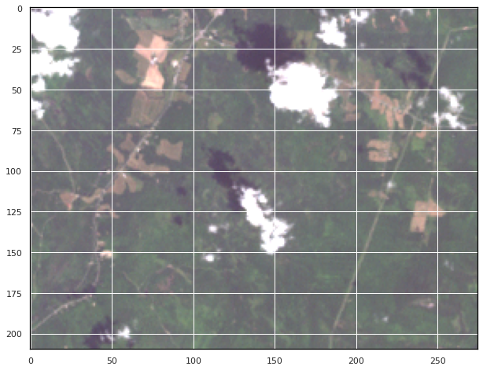
Identifiable Features
Town drying out, or crops out of season?
August
June

Slide 15
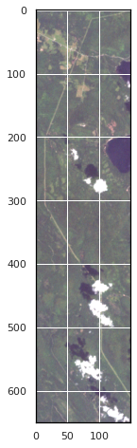
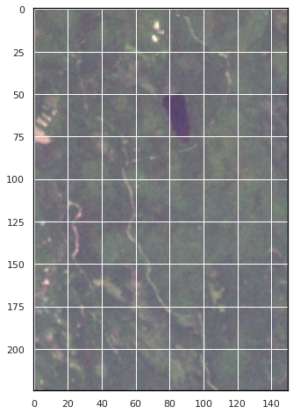
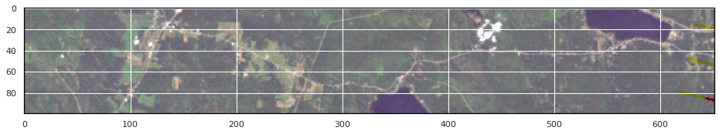
Identifiable Features
Roads and Trails

Slide 16
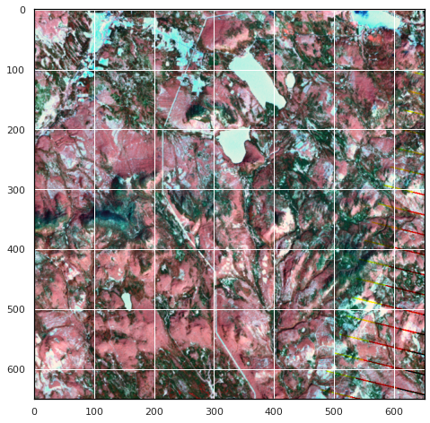
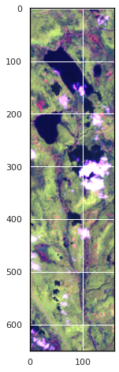
Identifiable Features
Water Features and Irrigation (confirming crops)

Slide 17
Quantitative Analysis and NDVI
NDVI (Normalized Difference Vegetation Index) is the normalized difference between near Infrared and red light
Can be used to assess vegetation health
Extracted from data then plotted using custom functions that combined earthpy, xarrays, and matplot
Only used single value, so not an RGB image

Slide 18
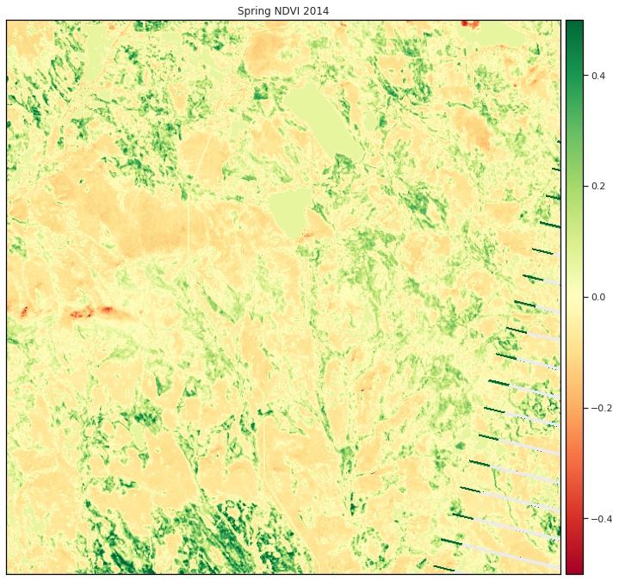
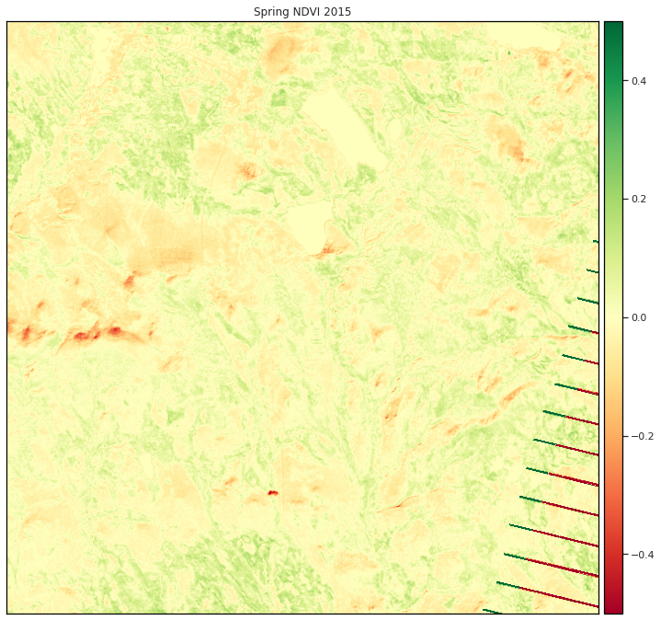
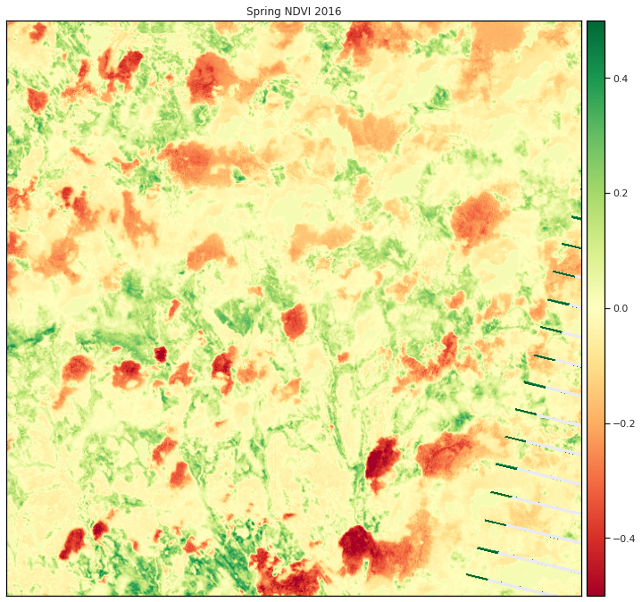
Spring NDVI

Slide 19
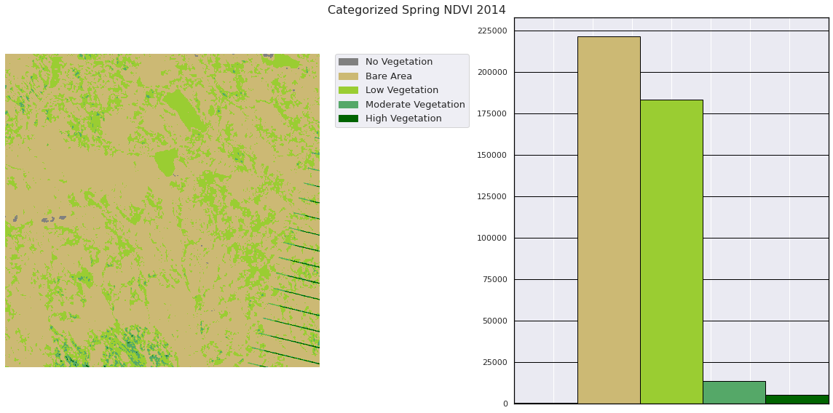
Spring NDVI

Slide 20
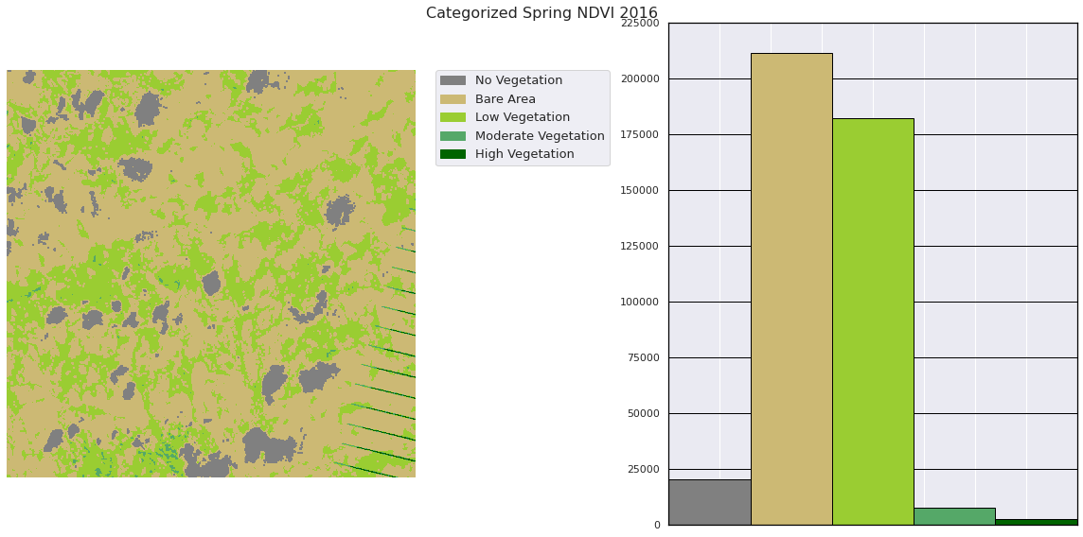
Spring NDVI

Slide 21
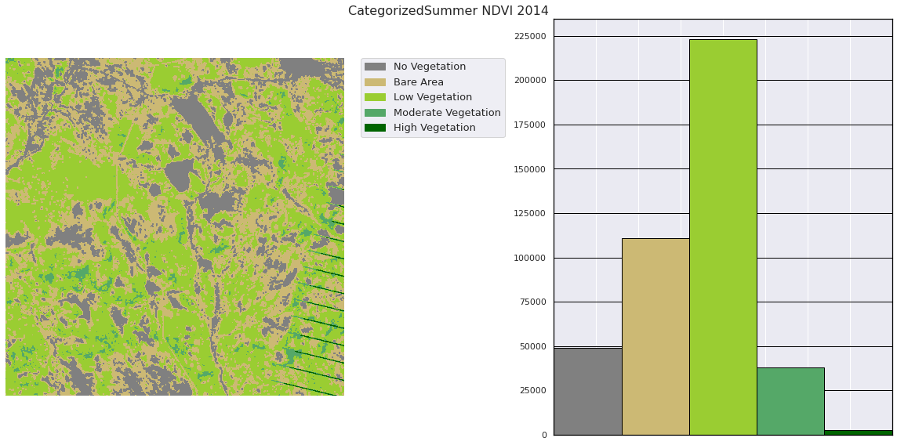
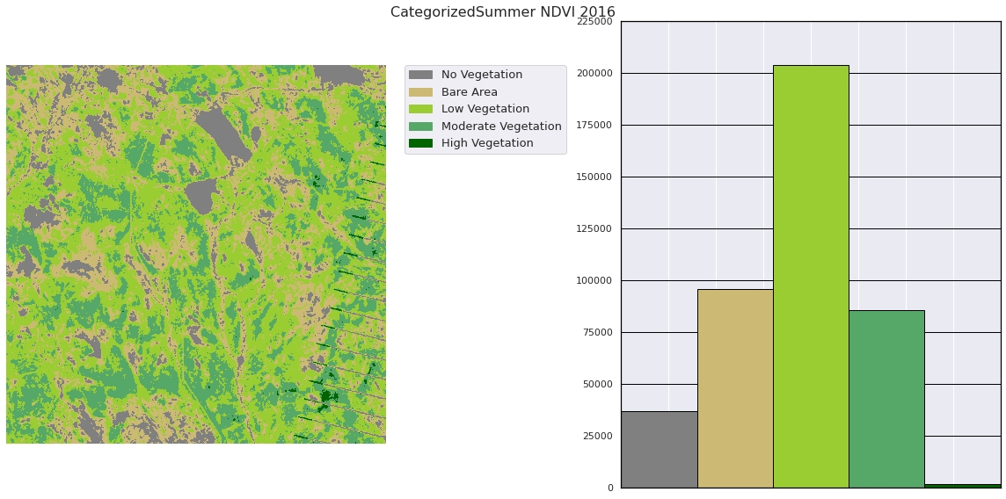
Summer NDVI
August vs June

Slide 22
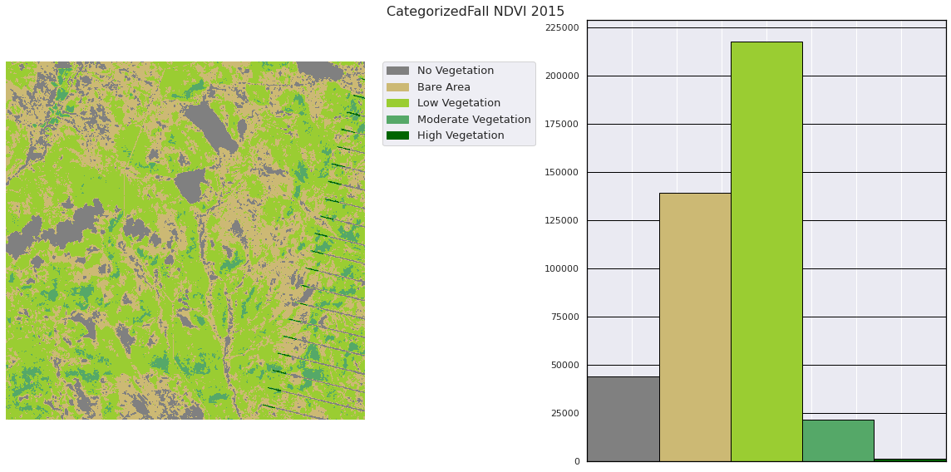
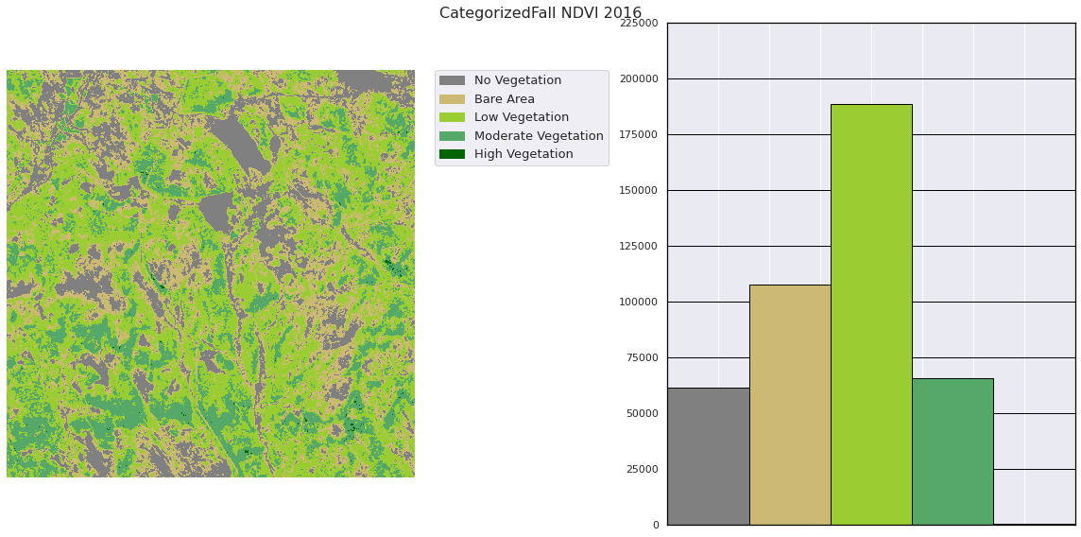
Fall NDVI
Both in September

Slide 23
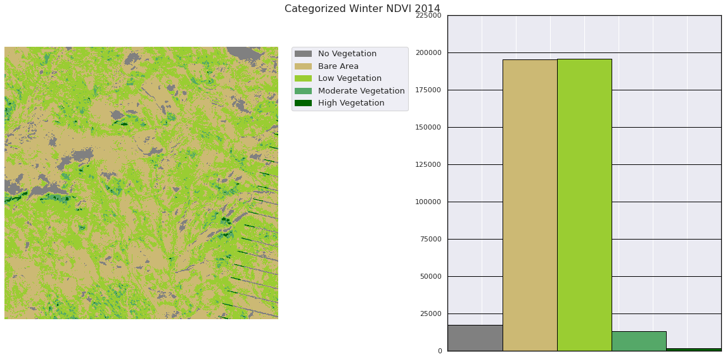
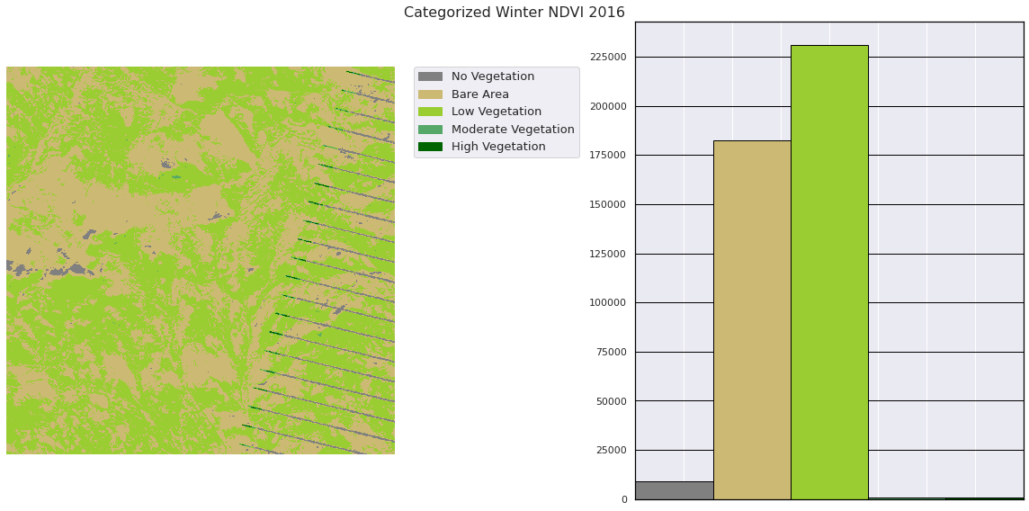
Winter NDVI
Both in December

Slide 24
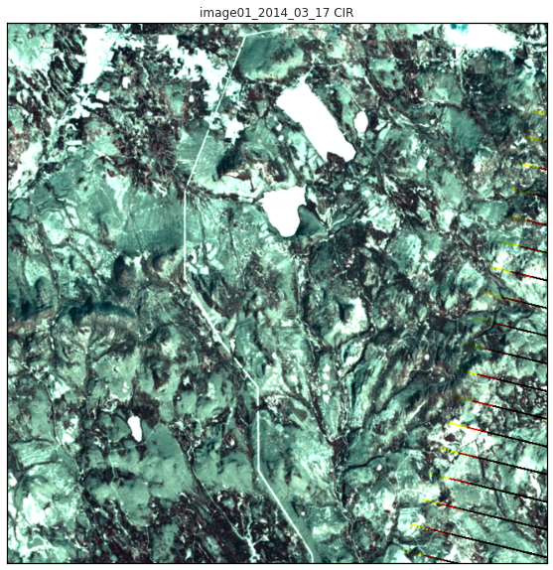
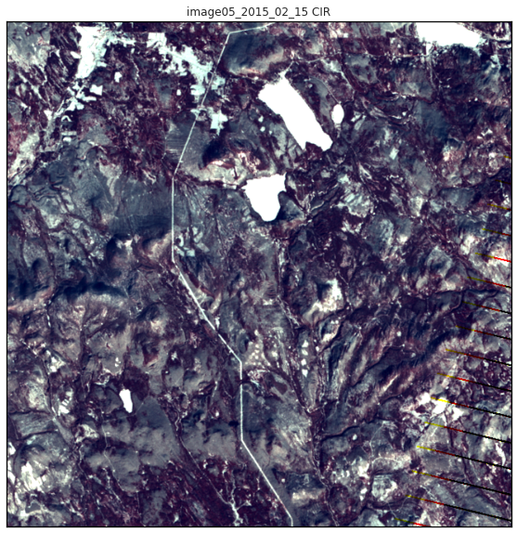
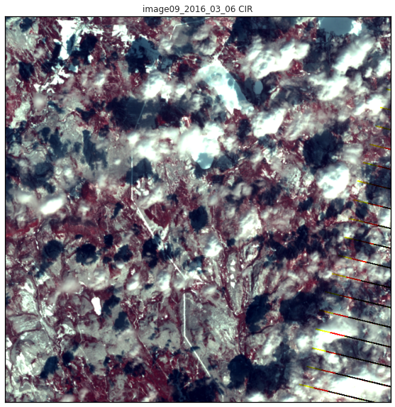
Quantitative Analysis With CIR
Using NIR, Red, and Green bands, this false-color combo can be useful in seeing changes in plant health as plants reflect NIR and green while absorbing red. You can see the deep red zones grow.

Slide 25
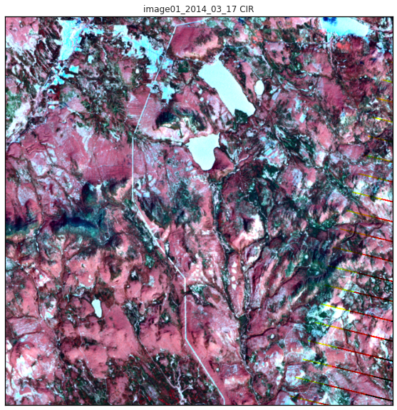
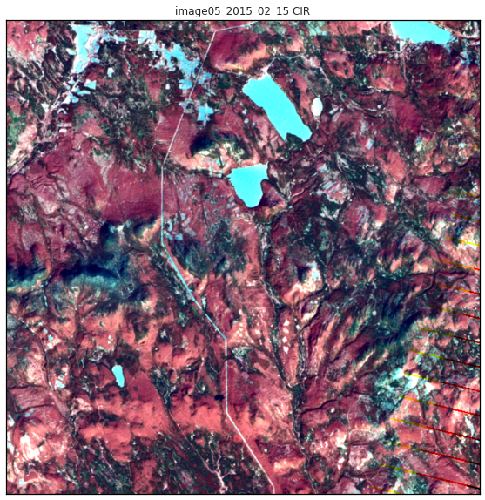
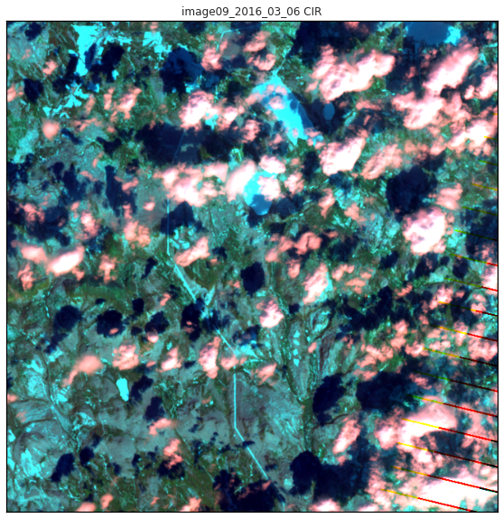
Quantitative Analysis With Shortwave IR, NIR, and Green
A common false-color band combination uses these three wavelegths to identify high concentrations of water, both in liquid water or wet soil. The 3rd image here has a lot more green and blue, indicating flooding.

Slide 26
Analysis Improvement
Most Landsat Images come equipped with a QA layer, which can be used to provide a mask layer for clouds.
The dropped cloud images would have still needed to be removed, however other images with light clouds or shadows would have benefited
With more images, mask layer can be replaced with a similar image, however given that we only had 3 per season this was not possible
Landsat resolution is on the lower end
Systematic ML approach for stretching images
Some images due to time of day or season had vastly different colors, making analysis with other false color combinations challenging

Slide 27
Conclusion
There is noticeable vegetation loss when comparing months directly in 2 out of 3 seasons (with the 3rd being winter), which certainly could be hurting the local fauna. Additionally, there seems to be signs of flooding or more precipitation in 2016 which might be impacting the habitat of the Pipit. There is certainly cause to be concerned for the Pipit.
Analysis with more Landsat images or ground level data is needed for a higher certainty on this hypothesis.

Slide 28
THANK YOU

